Slide 1
SQL Injection Lab

Slide 2
Preparation
Web container
ip address: www-10.9.0.5
It hosts a website www.seed-server.com
It is a employee management website
You need to modify the host file of your host to direct the URL to the ip.
SQL Container
ip address: 10.9.0.6
It mount database from host
So the db won’t get lost after you shutdown the container

Slide 3
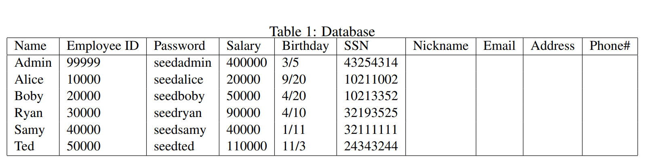
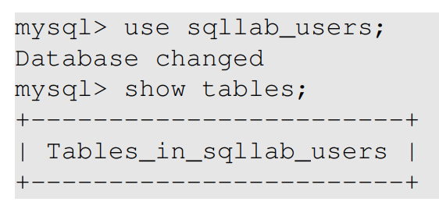

Task 1: Get familiar with SQL
A table to store employee information
In the sql container, you may check the content
mysql -u root -pdees

Slide 4
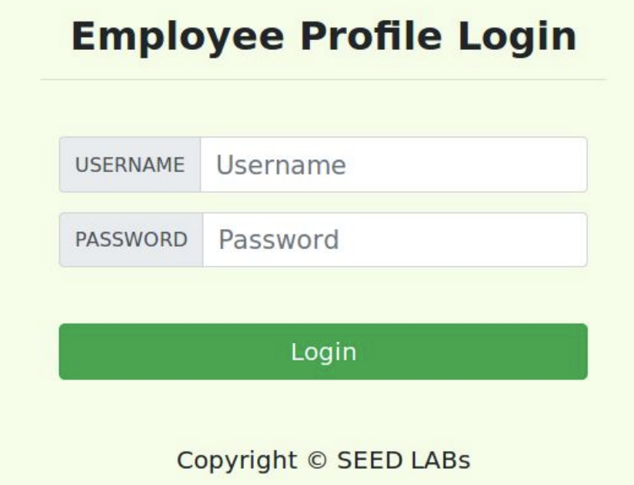
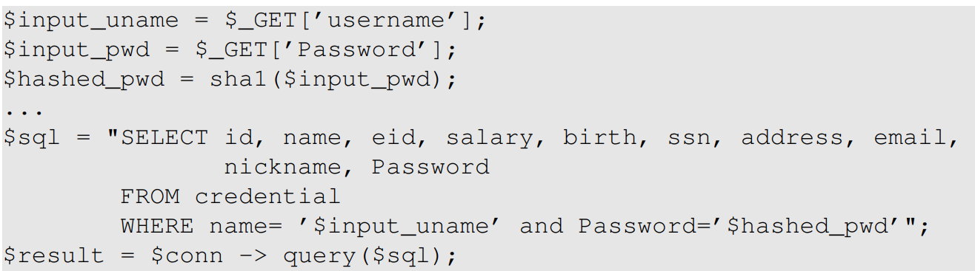
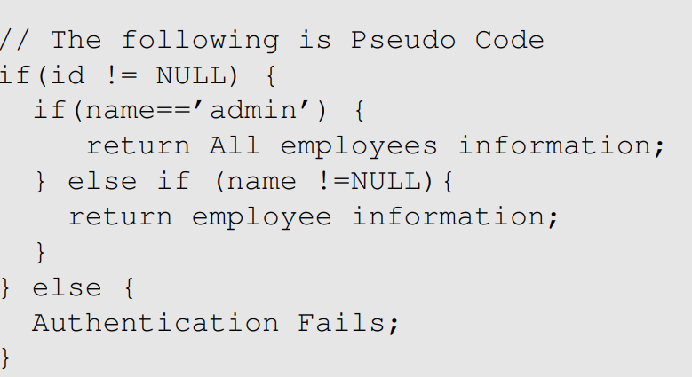
Task 2: Attack Select
Here is the backend code for this page

Slide 5
Task 2.1-2.2 Feeding Input
Decide what the username ($input_uname in PHP) and password ($password in PHP) should be
The password will be hashed by sha1
You may manipulate username
-- or # of sql statement prevents running the rest
Enter them in the webpage or use curl to generate GET request
curl ’www.seed-server.com/unsafe_home.php?username=alice&Password=11’
Bear in mind that the strings are firstly parsed by shell
curl args may not be allowed to have ‘
You may use %27

Slide 6
Task 2.3 Append New SQL Statement
You may not be able to run another stmt
mysqli_query() does not allow multi-query.
You need mysqli_multi_query()

Slide 7
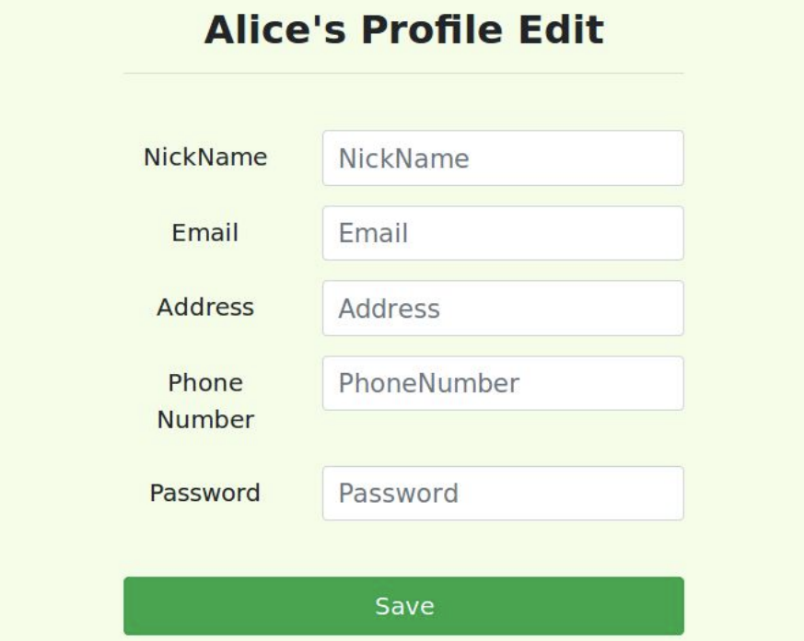
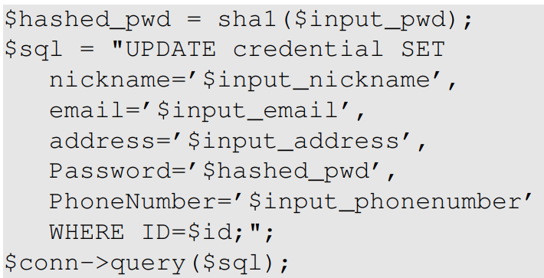
Task 3 Injection on UPDATE
Task 3.1 & 3.2:
Modify your and others’ salary
You may manipulate nickname to add the salary item
Task 3.3:
Modify password
You may need to know the sha1 value of a given password
http://www.sha1-online.com/

Slide 8
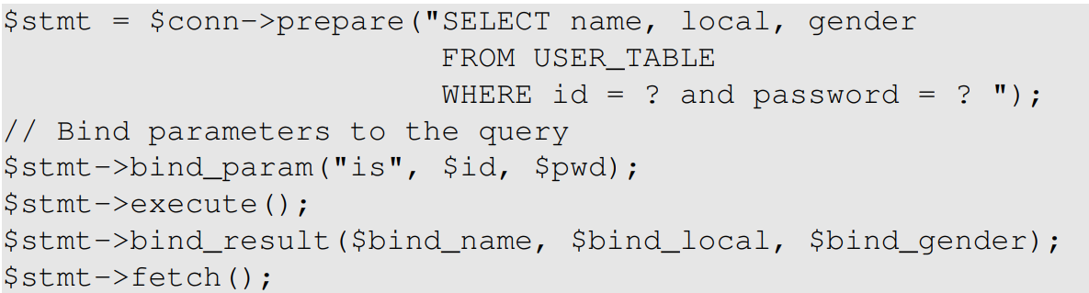
Task 4 Prepare Statement
Prepare the statement first
So the command syntax is fixed
Bind the parameters
They have no chance to modify the syntax
Executes
Bind results to PHP variables
Fetch results.

